Slide 1
Implementation of K-Means algorithm in determining pickup hotspots for Cabs
Naru Venkata Pavan Saish (20BDS0167)

Slide 2
AIM
Determining the pick-up hotspots for a Cab Company using the K-Means Algorithm

Slide 3
About the Project
Collect the data and clean it
Analyze the pick-up points
Implement K-means algorithm
Finding the hot-spots using the graphs

Slide 4
K-Means Algorithm
Step-1: Select the number K to decide the number of clusters.
Step-2: Select random K points or centroids. (It can be other from the input dataset).
Step-3: Assign each data point to their closest centroid, which will
form the predefined K clusters.
Step-4: Calculate the variance and place a new centroid of each
cluster.
Step-5: Repeat the third step, if any reassignment occurs, then go to
step-4 else stop the algorithm.

Slide 5
Advantages
Relatively simple to implement
Less in complexity
Scales to large data sets
K means may be computationally faster than hierarchical clustering for larger no of variables (if K is small)

Slide 6
Disadvantages
Difficult to predict the number of clusters (K-Value)
Different initial partitions can result in different final clusters
Clustering data of varying sizes and density.
Clustering outliers

Slide 7
Elbow Method
In the Elbow method, we are actually varying the number of clusters from 3 - 11. For each value of K, we calculate WCSS ( Within-Cluster Sum of Square ).
WCSS is the sum of squared distance between each point and the centroid in a cluster. When we plot the WCSS with the K value, the plot looks like an Elbow. As the number of clusters increases, the WCSS value will start to decrease. WCSS value is large when K = 1. When we analyze the graph we can see that the graph will rapidly change at a point and thus creating an elbow shape. From this point, the graph starts to move almost parallel to the X-axis. The K value corresponding to that point will be the optimal K value.

Slide 8
Code
from scipy.spatial import ConvexHull
Import numpy as np
import pandas as pd
from sklearn.cluster import KMeans
import numpy as np
import pandas as pd
import statsmodels.api as sm
import matplotlib.pyplot as plt
import seaborn as sns
from sklearn.cluster import KMeans
import numpy as np
df = pd.read_csv('Rides.csv')
### BUILD A TWO DIMENSIONS CLUSTER AGAIN ###
# k means

Slide 9
Code
kmeans = KMeans(n_clusters=3, random_state=0)
df['cluster'] = kmeans.fit_predict(df[['Longitude', 'Latitude']])
# get centroids
centroids = kmeans.cluster_centers_
cen_x = [i[0] for i in centroids]
cen_y = [i[1] for i in centroids]
## add to df
df['cen_x'] = df.cluster.map({0:cen_x[0], 1:cen_x[1], 2:cen_x[2]})
df['cen_y'] = df.cluster.map({0:cen_y[0], 1:cen_y[1], 2:cen_y[2]})
# define and map colors
colors = ['#DF2020', '#81DF20', '#2095DF']
df['c'] = df.cluster.map({0:colors[0], 1:colors[1], 2:colors[2]})
x = df.iloc[:, 4:6] # 1t for rows and second for columns
kmeans = KMeans(3)

Slide 10
Code
kmeans.fit(x) wcss = []
for i in range(1, 7):
kmeans = KMeans(i)
kmeans.fit(x)
wcss_iter = kmeans.inertia_
wcss.append(wcss_iter) number_clusters = range(1, 7)
plt.plot(number_clusters, wcss)
plt.title('The Elbow method')
plt.xlabel('Number of clusters')
plt.ylabel('WCSS')

Slide 11
Code
kmeans = KMeans(n_clusters=3, random_state=0)
df['cluster'] = kmeans.fit_predict(df[['Longitude', 'Latitude']])
# get centroids
centroids = kmeans.cluster_centers_
cen_x = [i[0] for i in centroids]
cen_y = [i[1] for i in centroids]
## add to df
df['cen_x'] = df.cluster.map({0:cen_x[0], 1:cen_x[1], 2:cen_x[2]})
df['cen_y'] = df.cluster.map({0:cen_y[0], 1:cen_y[1], 2:cen_y[2]})
# define and map colors
colors = ['#DF2020', '#81DF20', '#2095DF']
df['c'] = df.cluster.map({0:colors[0], 1:colors[1], 2:colors[2]})

Slide 12
Code
from scipy import interpolate
fig, ax = plt.subplots(1, figsize=(8,8))
plt.scatter(df.Longitude, df.Latitude, c=df.c, alpha = 0.6, s=10)
plt.scatter(cen_x, cen_y, marker='^', c=colors, s=70)
for i in df.cluster.unique():
# get the convex hull
points = df[df.cluster == i][['Longitude', 'Latitude']].values
hull = ConvexHull(points)
x_hull = np.append(points[hull.vertices,0],
points[hull.vertices,0][0])
y_hull = np.append(points[hull.vertices,1],
points[hull.vertices,1][0])
# interpolate

Slide 13
Code
dist = np.sqrt((x_hull[:-1]-x_hull[1:])**2+(y_hull[:-1]-y_hull[1:])**2)
dist_along = np.concatenate(([0], dist.cumsum()))
spline, u = interpolate.splprep([x_hull, y_hull],
u=dist_along, s=0)
interp_d = np.linspace(dist_along[0], dist_along[-1], 50)
interp_x, interp_y = interpolate.splev(interp_d, spline)
# plot shape
plt.fill(interp_x, interp_y, '--', c=colors[i], alpha=0.2)
# plt.xlim(0,200)
# plt.ylim(0,200)
z=1
p=1

Slide 14
Code
plt.ylim(25*z, 55*z)
plt.xlim(-125*p, 15*p)
plt.title('Cluster analysis')
plt.xlabel("Longitude")
plt.ylabel("Latitude")
plt.show()

Slide 15
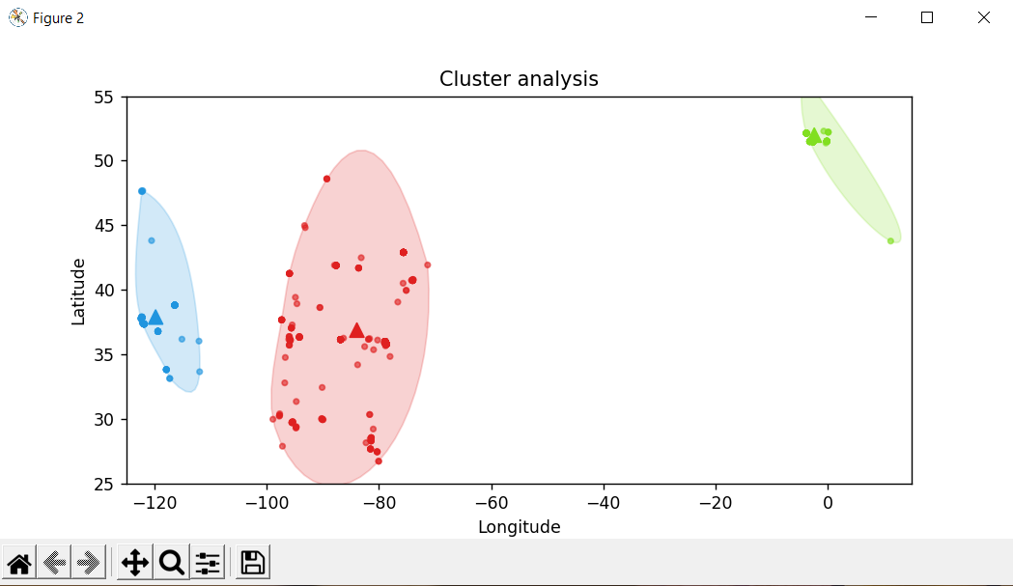
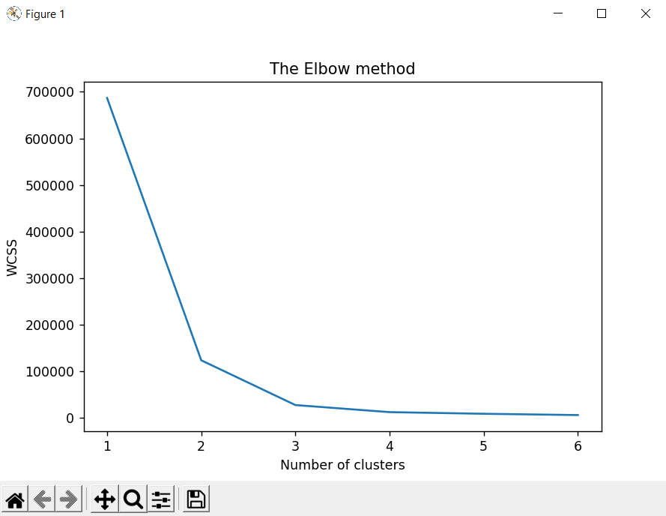
Output

Slide 16
Choosing K using Elbow method
In the Elbow method, we are actually varying the number of clusters ( K ) from 1 – 7. For each value of K, we are calculating WCSS (Within-Cluster Sum of Square). WCSS is the sum of squared distance between each point and the centroid in a cluster. When we plot the WCSS with the K value, the plot looks like an Elbow. The K value corresponding to the point where the bend occurs, is the optimal K value.
In the graph we obtained, the bend occurs as K = 3. Hence, that is the optimum number of clusters.

Slide 17
Output

Slide 18
Conclusion
The above code helps us to find the hotspots by implementing k means algorithm and elbow method.
From the geographic data points (latitudes and longitudes), we clustered them with the help of elbow method and then implemented the k means algorithm to find the hotspots.

